Slide 1
SymCheck - Sprint 5 Presentation
By:
Alan Singleton, Briana Figueroa, Morgan Franklin, Jasmine Washington, Sayema Islam, and Swapnil Kadekar
Notes:
Hello, my name is Jasmine Washington, and this is Team 5, HiddenAgility’s Sprint 5 presentation on our project called SymCheck. Team members include Alan Singleton, Briana Figueroa, Morgan Franklin, Sayema Islam, and Swapnil Kadekar.

Slide 2








Agenda
1. Project Overview
2. Sprint 4 vs. Sprint 5 and New Technologies
3. Sprint 5
4. Demo of New Features
5. Product Backlog
6. Timeline
7. Retrospectives
8. Conclusion
Notes:
On our agenda for today, we will discuss our project overview. This includes explaining what SymCheck is, what kind of personas are involved, and our plans for this semester. Next, we will do a comparison of Sprint 4 and Sprint 5 major stories completed to remind you of what we accomplished last Sprint. We will also highlight the new technologies that was used in this sprint. Then, we will dive into our Sprint 5 artifacts which include a review of our committed items and completed ones, our acceptance criteria, and test cases for our user stories. Followed by that, we will show you a demo of the new features added in Sprint 5. Then, we will go over our product backlog and explain each item. We will then show you how our product backlog will get done over the next few sprints. Next up is our retrospectives and we close with our conclusion. Presenting next is Sayema with our Project Overview.

Slide 3
Project Overview
Notes:
(Sayema Islam)

Slide 4

What is SymCheck?
SymCheck is an image-based self-diagnosis application
A patient's input image is fed into an original algorithm developed, tested, and run using TensorFlow's Keras library
[Currently] generates positive or negative diagnoses for 2 illnesses – chickenpox (varicella) and pink eye (conjunctivitis)
Does not require account creation or login, nor answering a long serious of monotonous questions (image-based)

Slide 5

Persona 1: Cindy the Single, Working Mother
Background Profile:
Cindy is a 32-year old single mother with 2 boys: Adrian (4 years old) and Simon (6 years old). She also has a full-time job as a business analyst, working around 80 hours a week.
Simon has recently developed a rash on his chest. Cindy called the family's pediatrician to seek a quick diagnosis, but they are reluctant to diagnose him without a physical visit.
How can SymCheck help?
Cindy could very much use an application to get a cursory diagnosis of her son's symptoms from the comfort of her own home or work-desk. This would allow her to potentially save an unnecessary visit and follow recommendations listed on the SymCheck site, or even shorten a visit to the doctor by simply having him verify the result in confidence.

Slide 6

Persona 2: Ryan the overwhelmed college student
Background Profile:
Ryan is a junior at Pace University. Not only is he swarmed with assignments, but he has also just started to notice strange skin lesions on his arm. Although he wants to get his skin checked, he just doesn’t have time to waste in his schedule to check in to a doctor's office or urgent care facility if it is not necessary.
How can SymCheck help?
Ryan needs a cursory method of diagnosis for his skin abnormality, without having to pay a physical visit to some medical facility.
Our SymCheck application can solve this dilemma, and if the application identifies his lesions as to being serious or even life-threatening, it can recommend that he definitively needs to prioritize a visit to the doctor or nearest hospital.

Slide 7
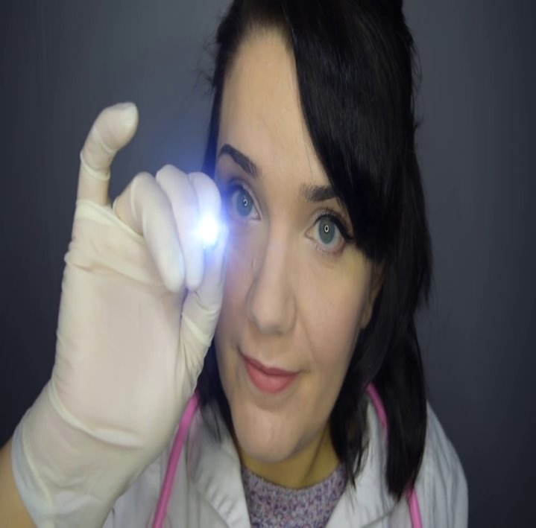
Persona 3: Lisa the Caring Nurse
Background Profile:
Lisa has 15 years of experience as a Nurse at various urgent care facilities. Now, during global COVID-19 pandemic, many of her patients complain to her about the waiting period to see a doctor.
How can SymCheck help?
In order to help minimize the number of patients in the office, Lisa seeks an application to help her patients determine whether or not their illness symptoms require immediate medical attention.
Given that Lisa wishes to refer her patients to a reliable, and convenient source of diagnosis, the SymCheck application could potentially offer guidance in determining what a patient's symptoms may indicate and thus provide recommendations for at-home remedies.
The use of SymCheck could thus also help in mediating the spread of COVID-19 by reducing the traffic in Urgent Care facilities.

Slide 8

Looking forward into this semester...
This year our team plans to undertake an extensive focus on adding various additional features to our application to make it even more convenient and user/patient friendly:
Image upload preview
Interactive chatbot
Convenient site navigation bar
Mobile-friendly website
Our team is also looking into adding more data to increase the accuracy of our existing prediction rates, as well as considering the addition of another non-threatening illness/condition
Current machine-learning algorithm accuracy: 78%
Addition of classification label for ringworm (tinea or dermatophytosis)
Image drawn from Shutterstock

Slide 9
Sprint 4 vs. Sprint 5
Notes:
(Swapnil Kadekar)

Slide 10
Comparison
Sprint 4
Sprint 5
We completed our machine learning algorithm to diagnose Chickenpox and Pinkeye.
The accuracy percentage is 78
We provided information about these illnesses such as when to see a doctor and typical symptoms.
This information is from the CDC
We added “Find nearest Emergency room” feature to our Image page and Results page.
Patients can find the nearest hospital or urgent care from their location
We added a new capability that allows you to see the image uploaded for confirmation purposes.
We added a chatbot to each page that acts as a virtual assistant for SymCheck.
It can direct users to various resources such as our GitHub, the CDC website, or reach us via email
We hosted our application to the cloud for easier accessibility.
Users can access SymCheck on any laptop or desktop
There is no need to install and run SymCheck on your device
Notes:
In Sprint 4, our focus was building the foundation of SymCheck, which is performing illness prediction based on images. We created an algorithm with a 78% accuracy of diagnosing chickenpox and pinkeye. We also provided information about these illnesses within our results page that explains what the symptoms are and when to see the doctor. This information is directly from the CDC because we are not license medical professionals. We also added a capability that allows users to find the nearest hospital or urgent care from their location.
In Sprint 5, our focus was developing a chatbot for SymCheck to act as a virtual assistant. Currently, it can direct users to various resources such as our GitHub Wiki, the CDC website, or reach us via email. We also added a capability that shows the user their uploaded image for confirmation before submitting their image. Lastly, we hosted SymCheck to the cloud so that users have easier access to our application.

Slide 11


Sprint 5 New Technologies
Natural language understanding platform
Dialogflow can analyze multiple types of input (text or audio inputs)
Advanced AI : BERT-based natural language understanding (NLU) model
Interactive, console-based, programming environment
Multi languages support
manage the environment for building and running code
Notes:
Next up, is Morgan and she will explain in more detail of Sprint 5, thank you.

Slide 12
Sprint 5
Notes:
(Morgan Franklin)

Slide 13
Sprint 5 Committed Tasks and Stories
Notes:
In Sprint 5, we have committed to the following tasks and user stories. This is sorted based on priority, so the highest priority was to create our chatbot. Next, was to find more images of chickenpox and pinkeye so that our ML algorithm could have a higher accuracy percentage. Then we decided to work on creating questions for a new “Advanced Prediction” page where users will answer yes or no to a series of questions that will either increase or decrease the patient’s prediction confidence. Then we also worked on cleaning up our code for better readability and consistency. Another user story was fulfilled by creating the capability to see uploaded images before submitting for diagnosis. We also redid all of our user stories and acceptance criteria's to reflect the proper type of user, which is patient. We also linked all of our stories, test cases and acceptance criteria together. Lastly we created this presentation for you!

Slide 14
Sprint 5 Completed Tasks and Stories
Items boxed in green were added mid-sprint
This was possible because repl.it is a collaborative coding environment and provided hosting capabilities.
Notes:
We not only completed all tasks within Sprint 5, but we also added a user story and a task. During our last Sprint, Sprint 4, we said that we needed to find a collaboration coding tool as our Retrospective. We were able to find this through repl.it. Lets look into our acceptance criteria and test cases for each of these stories.

Slide 15
Acceptance Criteria
Key | Summary | Label
HID-57 | Given that the patient is on the ImageUploadPage, when the patient uploads their image, then the user should see their uploaded image within the application. | Image Upload Page
HID-58 | Given that the patient is on any page of the SymCheck application, when the patient clicks on the chatbot's greeting, then a dialogue window will pop up in the bottom right corner. Given that the patient has a dialogue box opened with the chatbot, when the patient enters "pinkeye" or "chickenpox", then the chatbot will respond by telling the patient they should go to the CDC website. | All Pages
HID-62 | Given that the patient has a browser open, when the patient types in SymCheck's URL, then the SymCheck application should be accessible without any errors. | Cloud Access
Notes:
Read the table

Slide 16
Test Cases
Test Case For | Key | Test Cases | Test Data | Expected Results | Actual Results | Pass/Fail
Homepage | HID-58 | Chatbot | Hi, chicken pox, pink eye | Patient can interact with SymBot and receive a response | SymBot responds on all patient inputs such as hello, what is chickenpox, how can I speak to creaters of symcheck, etc. | P
Image Upload Page | HID-57 | Image reflection | pinkeye image file | Patient can see their uploaded image | After you select an image to upload, the page shows you the uploaded image | P
Image Upload Page | HID-58 | Chatbot | How do I upload an image? | Patient can interact with SymBot and receive a response | SymBot responds on all patient inputs such as hello, what is chickenpox, how can I speak to creaters of symcheck, etc. | P
Results | HID-58 | Chatbot | How can I get in touch with developers? | Patient can interact with SymBot and receive a response | SymBot responds on all patient inputs such as hello, what is chickenpox, how can I speak to creaters of symcheck, etc. | P
Cloud Access | HID-62 | Access via URL | https://symcheck.jazzymaya.repl.co/ | Patients can use SymCheck without any issues | Patients can use SymCheck without any issues | P
Notes:
Read the table

Slide 17
Sprint 5 Burndown Chart
This chart shows our story point burndown.
We have a velocity of 13 points.
We added an 8-point story mid sprint, that is why there is a spike on the 17th.
We finished the sprint early, that is why the red line stops on the 18th.
Notes:
Up next is Briana with our application demo.

Slide 18
Project Demo
*Demo was performed live and can be found at https://github.com/jazzymaya/HiddenAgility/wiki
Notes:
Briana Figueroa

Slide 19
Demo of New Capabilities
New Image Page Capability
Chatbot Capability

Slide 20
Product Backlog
Notes:
Hi this is Jasmine again and I will walk through our product backlog

Slide 21
Product Backlog
Notes:
Currently, we have 15 items total with 5 user stories.
-1st story will allow patients to do an optional questionnaire after uploading their image to receive a more accurate diagnosis. Questions would be based on their image results, for example, if a user is found to have chickenpox, one of the questions will ask if they had chickenpox in the past. Depending on their response, the confidence percentage may increase or decrease.
-2nd story: This user story requires us to make our application mobile friendly since anyone can access our application via a web browser.
-3rd story: This story requires us to have language within our Homepage that tells patients what illnesses SymCheck can diagnose. Although we only do a few, in the future it could be many and this information is crititcal for users to be able to understand if SymCheck is right for them.
4th story: Because we built a self diagnosing tool, it is very helpful to have an FAQ page where patients can find most common questions answered.
5th story: This story calls for user friendly deisgn principles. As of right now, SymCheck has buttons for each page and this needs to be upgraded to a navigation bar so that moving from page to page is seamless as possible.
Next, is our tasks to be completed. We will be adding a new illness, ringworm, to our list of image based diagnosis. We will also work on our next sprint presentations, update our technical paper, mauals and GitHub. We will also develop a python script to clear our media folder of user uploaded images for privacy purposes. If we are not able to provide a script, we will implement a database to secure image data confidentiality. We will also redesign SymCheck to provide a more elegant look and feel of the website, and add disclaimers for each page.
That is all for our product backlog, up next is Alan with our Timeline.

Slide 22
Timeline
Notes:
(Alan Singleton)

Slide 23
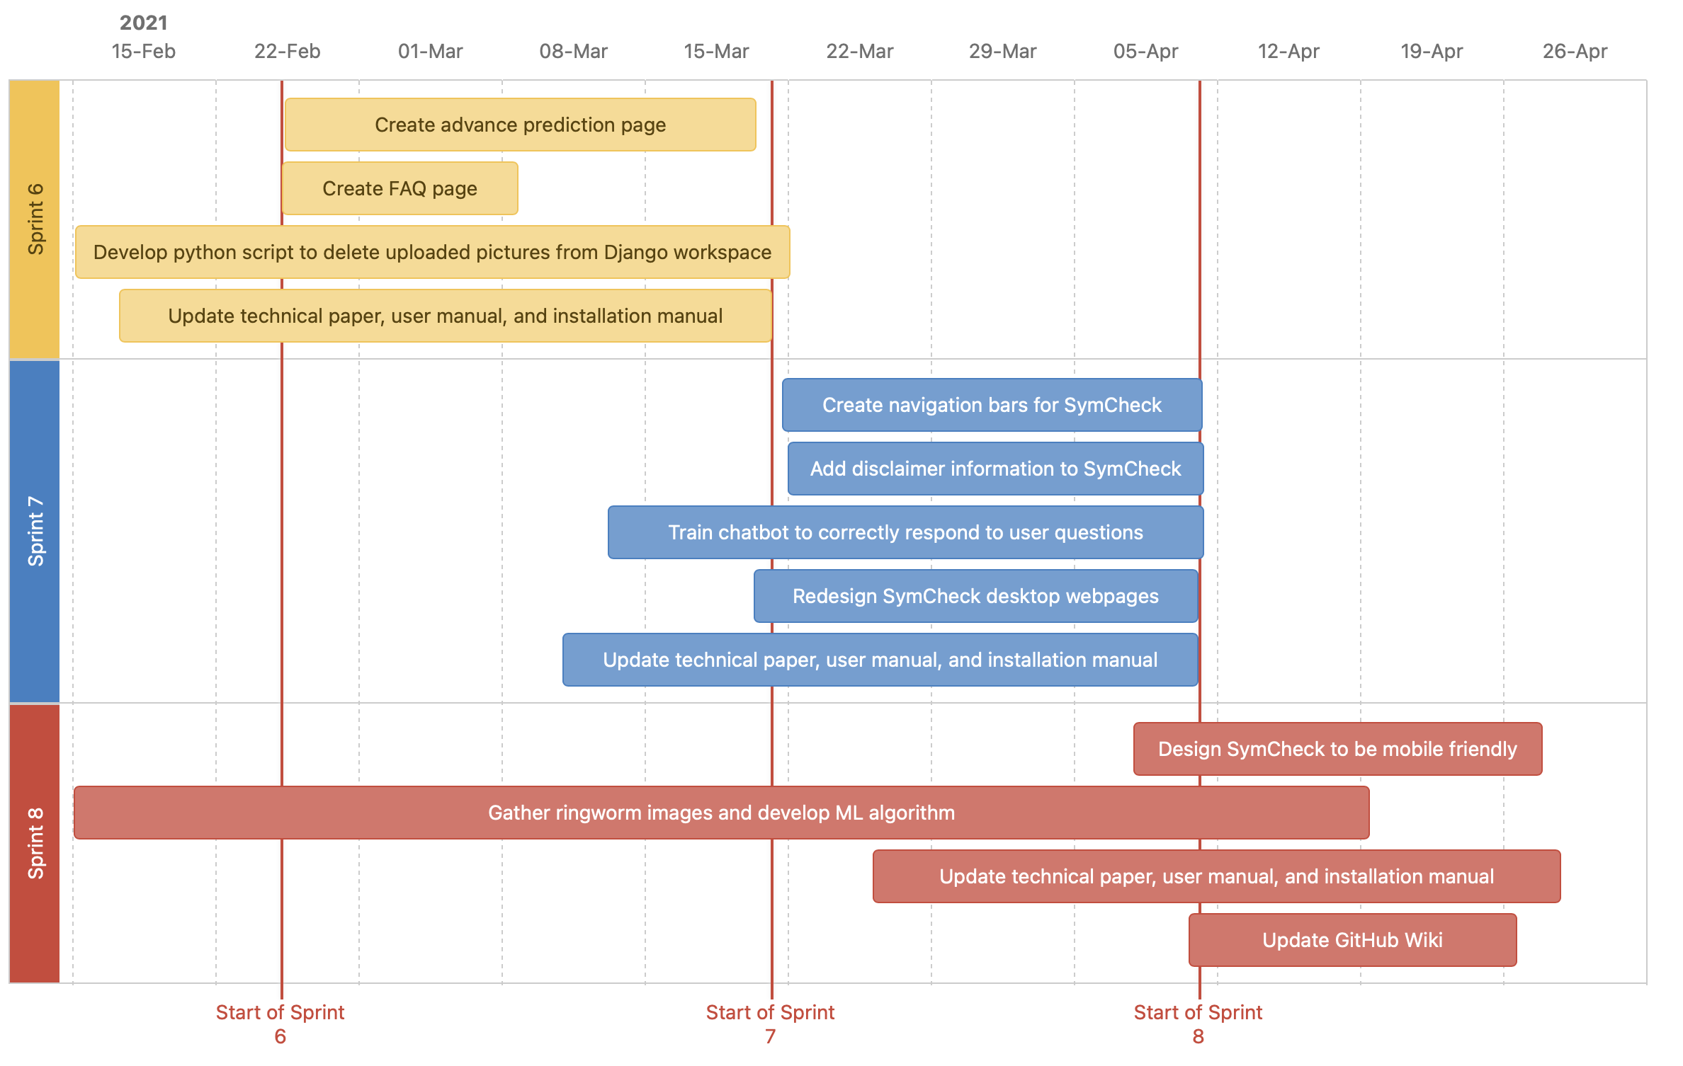
Timeline of Future Sprints
Notes:
Read information provided on timeline

Slide 24
Retrospectives
Notes:
(Alan Singleton)

Slide 25
Retrospectives
What went well
Using repl.it as our code collaboration tool and cloud hosting provider
Tri-weekly meetings to make sure roadblocks are avoided
What needs improvement
Sprint planned items needs to be enforced to avoid mid sprint scope changes
We need to work on stories and tasks in a timely manner
Next Steps
Read repl.it documentation for better understanding

Slide 26
Conclusion

Slide 27
Link to GitHub
https://github.com/jazzymaya/HiddenAgility/wiki
Link to SymCheck Website
https://symcheck.jazzymaya.repl.co/

